Slide 1
Quantum Game Problem
IONQ 2nd problem
Team : malatang is delicious!
Beomgyu Choi, Yeongseok Lee
2022-June.-29th

Slide 2

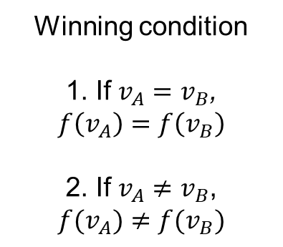
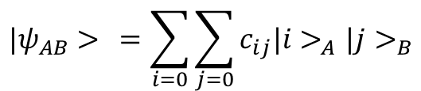
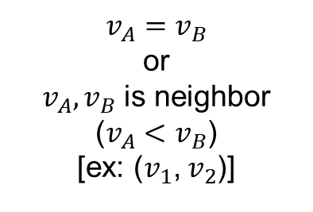




2.1 problem
Winning condition
1. If $v_{A}=v_{B}$,
$$f\left(v_{A}\right)=f\left(v_{B}\right)$$
2. If $v_{A}≠v_{B}$,
$$f(v_{A})≠{f(v}_{B})$$
$$v_{A}=v_{B}$$
or
$v_{A},v_{B}$ is neighbor
($v_{A}<v_{B}$)
[ex: ($v_{1}$, $v_{2}$)]
Referee
v1
v2
$$v_{A}$$
1
-1
$$v_{B}$$
Cyclic
graph
v5
v3
$$v_{1}$$
$$v_{2}$$
v4
$$|ψ_{AB}> =\sum_{i=0}{\sum_{j=0}{c_{ij}|i>_{A}|j>_{B}}}$$
Alice
Classical winning probability of odd cycle graph
P : 1-1/(2n) (even : 100%)
Bob

Slide 3
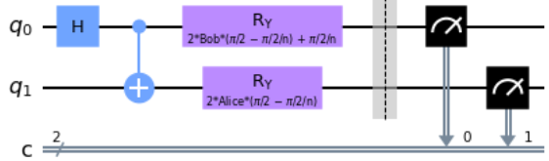
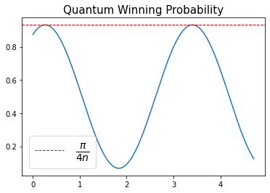
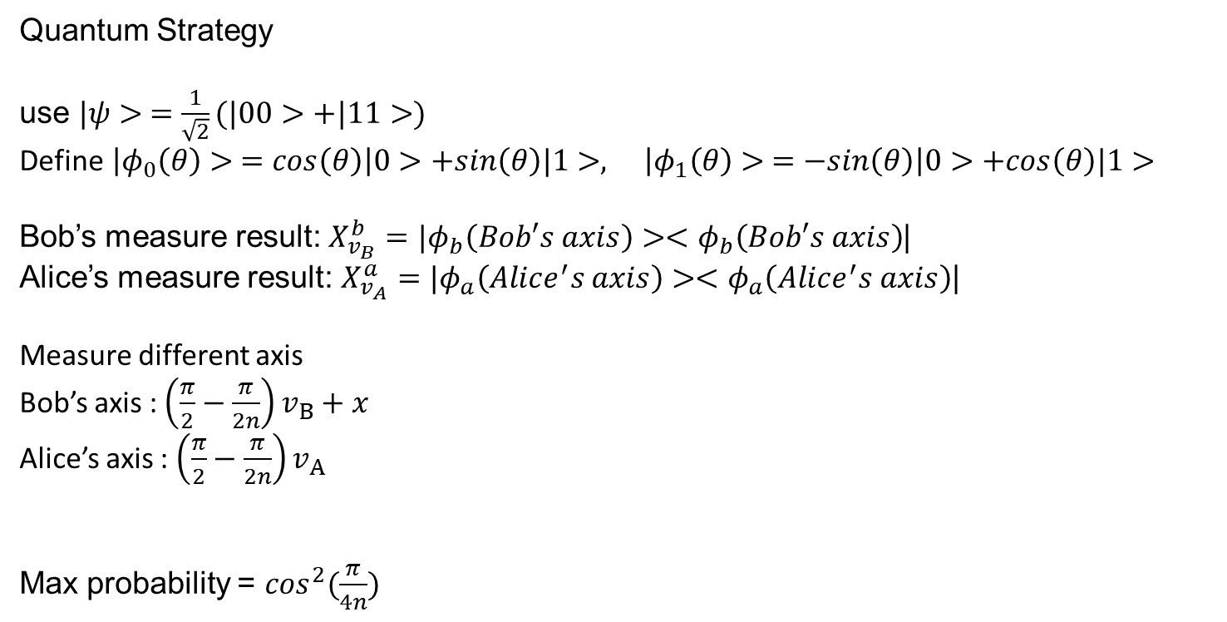
2.1 problem
Quantum Strategy
use $|ψ> =\frac{1}{\sqrt{2}}(|00>+|11>)$
Define $\left|φ_{0}\left(θ\right)> =cos\left(θ\right)\right|0>+sin\left(θ\right)|1>, \left|φ_{1}\left(θ\right)> =−sin\left(θ\right)\right|0>+cos\left(θ\right)|1>$
Bob’s measure result: $X_{v_{B}}^{b}=|φ_{b}\left(Bob′s axis\right)><φ_{b}\left(Bob′s axis\right)$|
Alice’s measure result: $X_{v_{A}}^{a}=|φ_{a}\left(Alice^{′}s axis\right)><φ_{a}\left(Alice^{′}s axis\right)$|
Measure different axis
Bob’s axis : $\left(\frac{π}{2}−\frac{π}{2n}\right)v_{B}+x$
Alice’s axis : $\left(\frac{π}{2}−\frac{π}{2n}\right)v_{A}$
Max probability = $\cos^{2}(\frac{π}{4n})$
Notes:
Pi/4n은 미분하면 나옴. –pi/2n은 n을 넣었을 때 |0>와 동일하게 하기 위해 (n이 홀수, pi/2-pi/2n이 항상 pi의 배수로 나온다.) 2를 곱해준 이유는 bloch sphere 고려

Slide 4
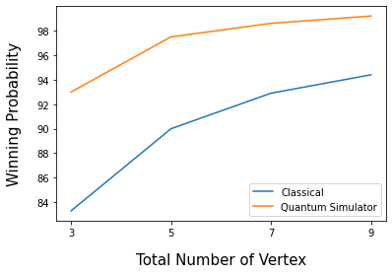
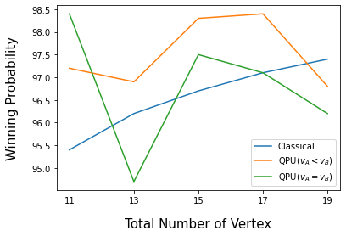
2.1 problem

Slide 5





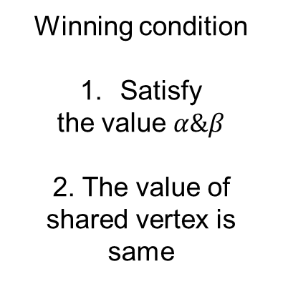


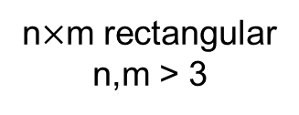




2.2 problem
Winning condition
Satisfy
the value $α\&β$
2. The value of
shared vertex is
same
Assign
random row and
column
$α\&β$=1 or -1
Referee
n$×$m rectangular
n,m > 3
1
-1
1
-1
$$α_{1}= 1$$
$$α_{A}$$
1
$$α_{2}=−1$$
$$β_{B}$$
-1
$$α_{3}$$
$$α_{1}$$
1
…
…
$$β_{1}$$
$$β_{1}=−1$$
$$β_{2}$$
$$β_{3}$$
$$|ψ_{AB}> =\sum_{i=0}{\sum_{j=0}{c_{ij}|i>_{A}|j>_{B}}}$$
Alice
Bob
If the number of row & column value -1 is odd, Winning probability: $1−\frac{1}{m×n}$ (even : 100%)

Slide 6














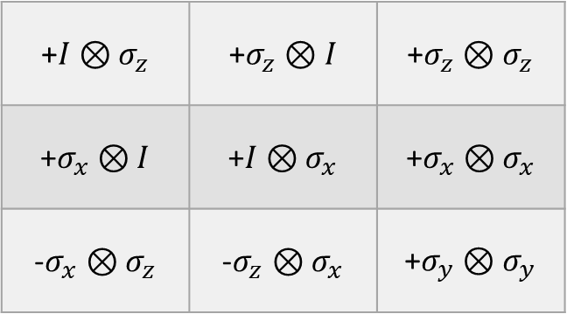





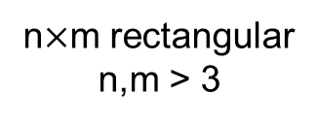
2.2 problem
n$×$m rectangular
n,m > 3
Delete!
1
-1
1
-1
$$α_{1}= 1$$
1
-1
1
-1
$$α_{2}=1$$
-1
1
-1
$$α_{1}=1$$
-1
$$α_{3}=1$$
1
-1
$$α_{2}=−1$$
-1
1
1
-1
1
1
1
-1
1
?
$$α_{4}=1$$
-1
1
?
$$α_{3}=1$$
$$β_{1}=−1$$
-1
-1
1
$$β_{1}=1$$
-1
-1
+$I⊗σ_{z}$ | +$σ_{z}⊗I$ | +$σ_{z}⊗σ_{z}$
+$σ_{x}⊗I$ | +$I⊗σ_{x}$ | +$σ_{x}⊗σ_{x}$
-$σ_{x}⊗σ_{z}$ | -$σ_{z}⊗σ_{x}$ | +$σ_{y}⊗σ_{y}$
$$α_{1}=1$$
1
1
1
$$α_{1}=1$$
1
-1
-1
$$α_{2}=1$$
$$α_{2}=1$$
$$α_{3}=1$$
-1
-1
1
?
1
$$α_{3}=1$$
$$β_{1}=−1$$
-1
-1
$$β_{1}=−1$$
$$β_{2}=−1$$
$$β_{3}=−1$$

Slide 7




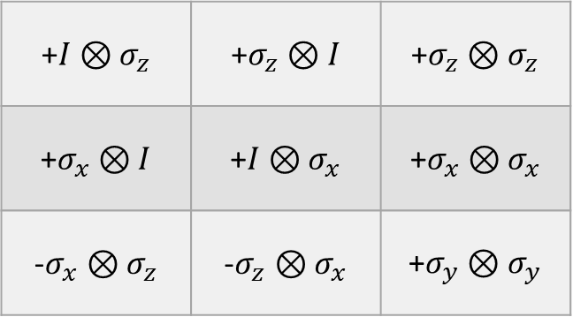





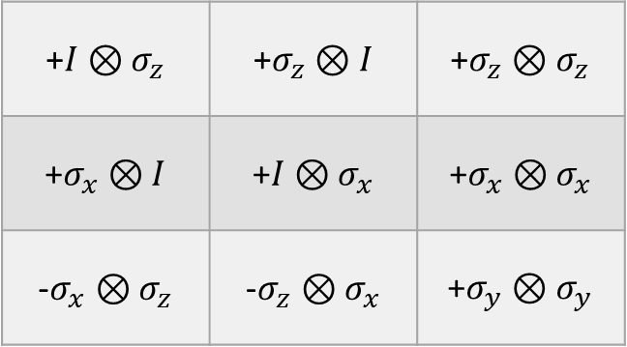
2.2 problem
+$I⊗σ_{z}$ | +$σ_{z}⊗I$ | +$σ_{z}⊗σ_{z}$
+$σ_{x}⊗I$ | +$I⊗σ_{x}$ | +$σ_{x}⊗σ_{x}$
-$σ_{x}⊗σ_{z}$ | -$σ_{z}⊗σ_{x}$ | +$σ_{y}⊗σ_{y}$
+$I⊗σ_{z}$ | +$σ_{z}⊗I$ | +$σ_{z}⊗σ_{z}$
+$σ_{x}⊗I$ | +$I⊗σ_{x}$ | +$σ_{x}⊗σ_{x}$
-$σ_{x}⊗σ_{z}$ | -$σ_{z}⊗σ_{x}$ | +$σ_{y}⊗σ_{y}$
$$α_{1}=1$$
$$α_{2}=1$$
$$α_{3}=1$$
$$β_{1}=−1$$
$$β_{2}=−1$$
$$β_{3}=−1$$
$$β_{1}=−1$$
$$β_{2}=−1$$
$$β_{3}=−1$$
Measure Blue area, then we can get Red area
Because basis in Blue is single qubit basis so it is independent
If we want to get Green area simultaneously, then we cannot use single qubit basis so we must use entangled basis

Slide 8
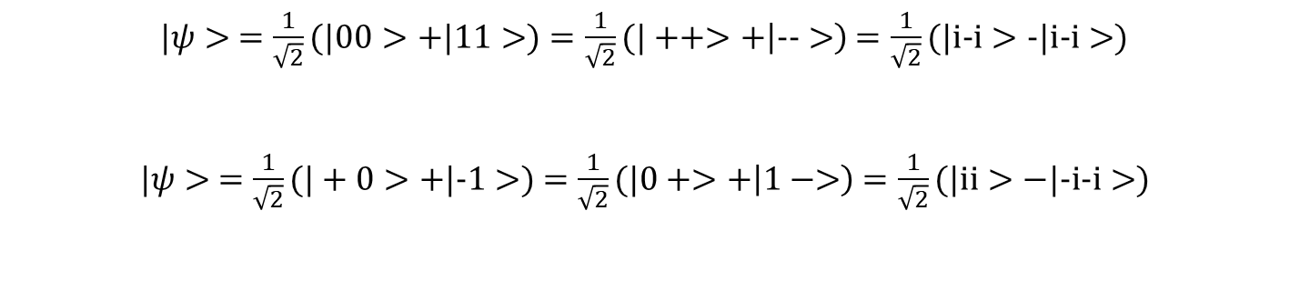
2.2 problem
+$I⊗σ_{z}$ | +$σ_{z}⊗I$ | +$σ_{z}⊗σ_{z}$
+$σ_{x}⊗I$ | +$I⊗σ_{x}$ | +$σ_{x}⊗σ_{x}$
-$σ_{x}⊗σ_{z}$ | -$σ_{z}⊗σ_{x}$ | +$σ_{y}⊗σ_{y}$
+$I⊗σ_{z}$ | +$σ_{z}⊗I$ | +$σ_{z}⊗σ_{z}$
+$σ_{x}⊗I$ | +$I⊗σ_{x}$ | +$σ_{x}⊗σ_{x}$
-$σ_{x}⊗σ_{z}$ | -$σ_{z}⊗σ_{x}$ | +$σ_{y}⊗σ_{y}$
$$α_{1}=1$$
$$α_{2}=1$$
$$α_{3}=1$$
$$β_{1}=−1$$
$$β_{2}=−1$$
$$β_{3}=−1$$
$$β_{1}=−1$$
$$β_{2}=−1$$
$$β_{3}=−1$$
$|ψ> =\frac{1}{\sqrt{2}}(|00>+|11>)$ $=\frac{1}{\sqrt{2}}(|++>+\left|-->\right)$ $=\frac{1}{\sqrt{2}}(|i-i>-|i-i>)$
$|ψ> =\frac{1}{\sqrt{2}}(|+0>+|-1>)$ $=\frac{1}{\sqrt{2}}(|0+>+\left|1−>\right)$ $=\frac{1}{\sqrt{2}}(|ii>−|-i-i>)$

Slide 9
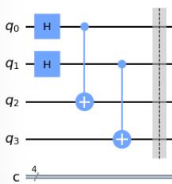








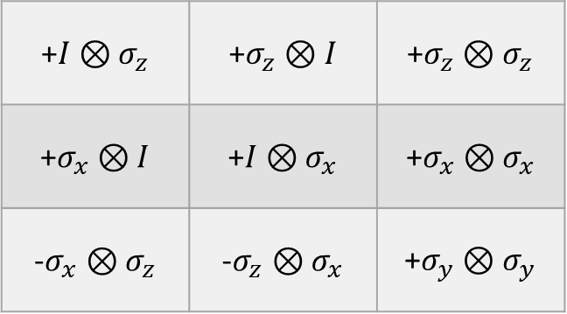




2.2 problem
+$I⊗σ_{z}$ | +$σ_{z}⊗I$ | +$σ_{z}⊗σ_{z}$
+$σ_{x}⊗I$ | +$I⊗σ_{x}$ | +$σ_{x}⊗σ_{x}$
-$σ_{x}⊗σ_{z}$ | -$σ_{z}⊗σ_{x}$ | +$σ_{y}⊗σ_{y}$
$$α_{1}=1$$
$$α_{2}=1$$
$$α_{3}=1$$
$$β_{1}=−1$$
$$β_{2}=−1$$
$$β_{3}=−1$$
Entangled state
Row 1
Row 2
Row 3
Alice’s case
Bob’s case
Column 1
Column 2
Column 3
Winning Probability of Simulator : 100%
Notes:
서킷에 게이트를 저렇게 건 이유 설명
Entangled state 설명할 때 둘이 entangle 된 state를 가져가기 때문에 Alice가 측정한 값을 Bob도 똑같이 측정할 수 밖에 없다는 것을 설명.

Slide 10
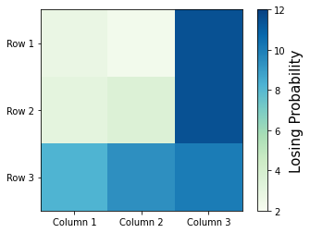
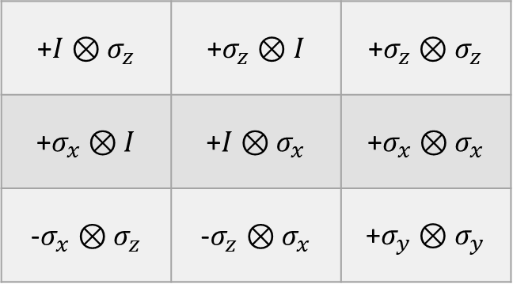
2.2 problem
Error Depending on Shared Vertex
+$I⊗σ_{z}$ | +$σ_{z}⊗I$ | +$σ_{z}⊗σ_{z}$
+$σ_{x}⊗I$ | +$I⊗σ_{x}$ | +$σ_{x}⊗σ_{x}$
-$σ_{x}⊗σ_{z}$ | -$σ_{z}⊗σ_{x}$ | +$σ_{y}⊗σ_{y}$
2.73%
2.25%
11.43%
3.02%
3.51%
11.43%
8.20%
9.37%
10.02%
Winning probability depending on QPU result : 93.12%
Minimum winning probability of classical : 93.75%
Notes:
Entangled state를 쓰게 되는 곳에는 그로 인한 noise가 많이 끼게 된다는 것을 설명.

Slide 11

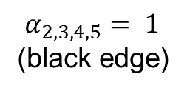
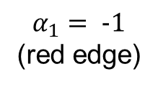
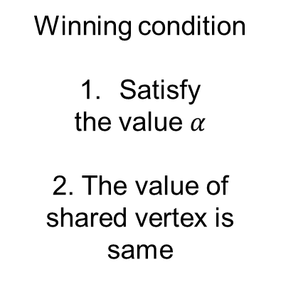


2.3 problem
Winning condition
Satisfy
the value $α$
2. The value of
shared vertex is
same
Assign
random edge($α$)
And vertex($β$) which
is on $α$
$α\&β$=1 or -1
Referee
$$β_{2}$$
$$α_{1}= -1$$
(red edge)
$$α_{A}$$
$$α_{2,3,4,5}= 1$$
(black edge)
$$β_{B}$$
$$α_{1}$$
$$β_{2}$$
$$|ψ_{AB}> =\sum_{i=0}{\sum_{j=0}{c_{ij}|i>_{A}|j>_{B}}}$$
Alice
Bob

Slide 12
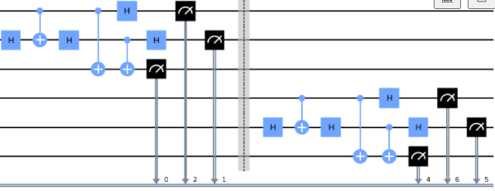
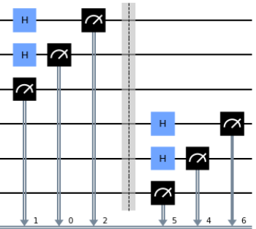
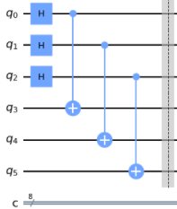
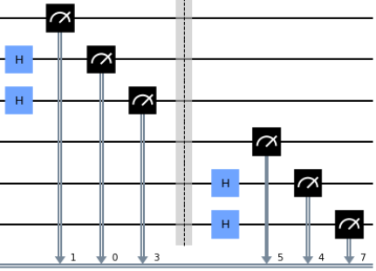
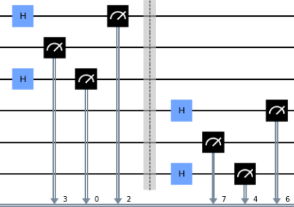
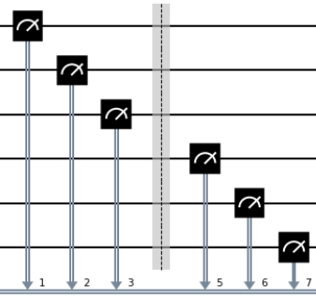
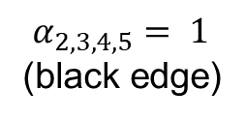
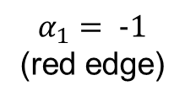
2.3 problem
IIX
ZXX
XZX
$$α_{1}= -1$$
(red edge)
ZZZ
XXZ
$$α_{2,3,4,5}= 1$$
(black edge)
ZII
XII
IIZ
IIZ
IZI
edge 1
IXI
edge 2
Entangled state
edge 3
edge 4
edge 5

Slide 13
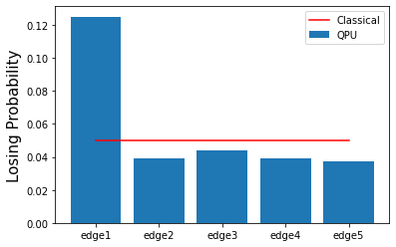
2.3 problem
IIX
ZXX
XZX
$$α_{1}= -1$$
(red edge)
ZZZ
XXZ
$$α_{2,3,4,5}= 1$$
(black edge)
ZII
XII
IXI
IZI
Winning Probability
Of Classical : 95%
Winning Probability
of Simulator: 100%
Winning Probability
Depending on QPU: 94.31%

Slide 14
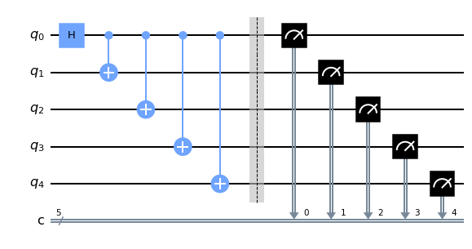
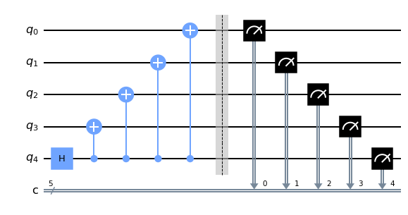
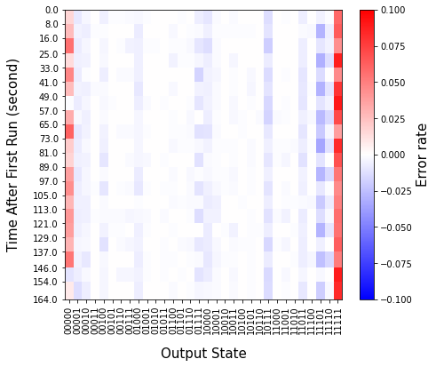
Further thing
Odd th circuit
Even th circuit
Calculation to take turn these two circuit
QPU
Probability
Ideal
Probability
Errors
-
=
20
Iteration

Slide 15
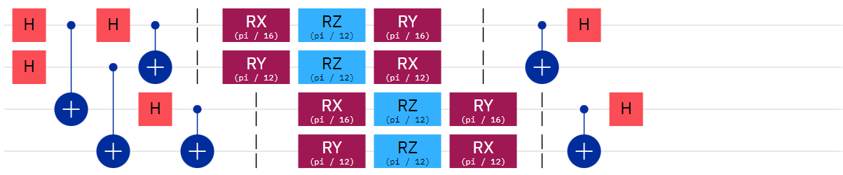
Further thing
Single qubit gate fidelity : 88.31%
Two qubit gate fidelity : 78.84%

